Slide 1

Jenkins Basics

Slide 2
What is Jenkins?
Jenkins is an open-source automation tool written in Java programming language that allows continuous integration.
Jenkins builds and tests our software projects which continuously making it easier for developers to integrate changes to the project and making it easier for users to obtain a fresh build.
It also allows us to continuously deliver our software by integrating with many testing and deployment technologies.
Jenkins offers a straightforward way to set up a continuous integration or continuous delivery environment for almost any combination of languages and source code repositories using pipelines, as well as automating other routine development tasks.
With the help of Jenkins, organizations can speed up the software development process through automation. Jenkins adds development life-cycle processes of all kinds, including build, document, test, package, stage, deploy static analysis and much more.
Jenkins achieves CI (Continuous Integration) with the help of plugins. Plugins is used to allow the integration of various DevOps stages. If you want to integrate a particular tool, you must install the plugins for that tool. For example: Maven 2 Project, Git, HTML Publisher, Amazon EC2, etc.
For example: If any organization is developing a project, then Jenkins will continuously test your project builds and show you the errors in early stages of your development.

Slide 3
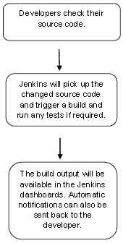
Work Flow
Possible steps executed by Jenkins are for example:
Perform a software build using a build system like Gradle or Maven Apache
Execute a shell script
Archive a build result
Running software tests

Slide 4
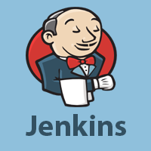
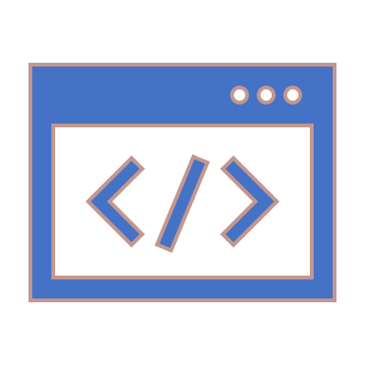
History of Jenkins
Kohsuke Kawaguchi, who is a Java developer, working at SUN Microsystems, was tired of building the code and fixing errors repetitively. In 2004, he created an automation server called Hudson that automates build and test task.
In 2011, Oracle who owned Sun Microsystems had a dispute with Hudson open source community, so they forked Hudson and renamed it as Jenkins.
Both Hudson and Jenkins continued to operate independently. But in short span of time, Jenkins acquired a lot of contributors and projects while Hudson remained with only 32 projects. Then with time, Jenkins became more popular, and Hudson is not maintained anymore.

Slide 5

Continuous Integration with Jenkins
Let's consider a scenario where the complete source code of the application was built and then deployed on test server for testing. It sounds like a perfect way to develop software, but this process has many problems.
Developer teams must wait till the complete software is developed for the test results.
There is a high prospect that the test results might show multiple bugs. It was tough for developers to locate those bugs because they have to check the entire source code of the application.
It slows the software delivery process.
Continuous feedback pertaining to things like architectural or coding issues, build failures, test status and file release uploads was missing due to which the quality of software can go down.
The whole process was manual which increases the threat of frequent failure.
It is obvious from the above stated problems that not only the software delivery process became slow, but the quality of software also went down. This leads to customer dissatisfaction.

Slide 6
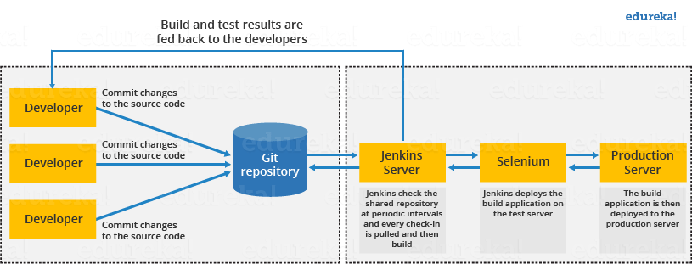
Solution
So, to overcome such problem there was a need for a system to exist where developers can continuously trigger a build and test for every change made in the source code.
This is what Continuous Integration (CI) is all about. Jenkins is the most mature Continuous Integration tool available so let us see how Continuous Integration with Jenkins overcame the above shortcomings.
Let's see how Jenkins works. The above diagram is representing the following functions:
First, a developer commits the code to the source code repository. Meanwhile, the Jenkins checks the repository at regular intervals for changes.
Soon after a commit occurs, the Jenkins server finds the changes that have occurred in the source code repository. Jenkins will draw those changes and will start preparing a new build.
If the build fails, then the concerned team will be notified.
If built is successful, then Jenkins server deploys the built in the test server.
After testing, Jenkins server generates a feedback and then notifies the developers about the build and test results.
It will continue to verify the source code repository for changes made in the source code and the whole process keeps on repeating.

Slide 7

Advantages of Jenkins
It is an open-source tool.
It is free of cost.
It does not require additional installations or components. Means it is easy to install.
Easily configurable.
It supports 1000 or more plugins to ease your work. If a plugin does not exist, you can write the script for it and share with community.
It is built in java and hence it is portable.
It is platform independent. It is available for all platforms and different operating systems. Like OS X, Windows or Linux.
Easy support, since its open source and widely used.
Jenkins also supports cloud-based architecture so that we can deploy Jenkins in cloud-based platforms.

Slide 8

Disadvantages of Jenkins
Its interface is out dated and not user friendly compared to current user interface trends.
Not easy to maintain it because it runs on a server and requires some skills as server administrator to monitor its activity.
CI regularly breaks due to some small setting changes. CI will be paused and therefore requires some developer's team attention.

Slide 9
Jenkins and Java
Jenkins is written in Java, a platform-independent programming language. Like with any other Java application, it can be installed on a variety of operating systems such as Linux, Windows, MacOS, etc.

Slide 10
Prerequisites for Installing Jenkins
Prior to installing Jenkins, you need to ensure that your system at least meets minimum hardware and software requirements:
256MB RAM
1 GB of disk space (10 GB if running as a Docker container)
Java 8 or Java 11
Modern web browsers - Google Chrome, Mozilla Firefox, Microsoft Internet Explorer, Apple Safari.
These minimum requirements are good enough to get you started, say for dev or test purposes. However, these need to be fine-tuned for production as production systems need a lot more resources.

Slide 11
Installation Channels
Jenkins is distributed via many channels:
Standalone WAR
Unix package managers (RPM, DEB, etc.)
Windows installers
Containers

Slide 12
Installation Channels: Standalone WAR
Using this method, Jenkins runs as a standalone application in its own process with its embedded Java servlet container, Jetty. This standalone application can be downloaded as a Java WAR (Web Application Archive) file with .war extension. This WAR file can run on any operating system, Linux, Windows, Mac OS, etc.
Here are the steps to launch Jenkins as a standalone war:
Download the jenkins.war file from the Jenkins project page.
Launch a terminal window, and run the following command: java -jar jenkins.war
By default, Jenkins uses port 8080. Your Jenkins application will be available at http://<Your IP Address>:8080. You can pass additional JVM arguments by specifying JENKINS_OPTS and JAVA_OPTS to the Java call as shown below: java ${JAVA_OPTS} -jar jenkins.war ${JENKINS_OPTS}
Here is an example of using startup flags: java -Dhudson.footerURL=http://example.org -jar jenkins.war \ --httpPort=8083 --prefix=/ci --httpListenAddress=127.0.0.1
In this example:
setting the Java system property (JAVA_OPTS) -Dhudson.footerURL=http://example.org will change the default footer on the Jenkins UI to http://example.com
--httpPort, --prefix, and --httpListenAddress are the flags provided as JENKINS_OPTS
--httpPort=8083 will set the Jenkins port to 8083 instead of the default 8080
--prefix=/ci will add a prefix to the end of the Jenkins URL
--httpListenAddress=127.0.0.1 binds Jenkins to the IP address.
Finally, a Jenkins service launched by above command will be reachable only on http://127.0.0.1:8083/ci.

Slide 13
Installation Channels: Linux Package Managers
Linux package managers provide a stable and automated way to install and manage a variety of programs. You can use Linux package managers, such as RPM, DEB, OpenSUSE, etc., to install Jenkins.
The standalone WAR file (jenkins.war) still forms the basis for the package manager installation. However, it has some added benefits such as automatic creation of Jenkins user, start-up scripts, log rotation, etc.
Here is an example of how you can install Jenkins on Ubuntu using the APT package manager. You will need to import the GPG key for the APT repo, add the repo to the list of sources, update the package index, and install.
Import the GPG key for Jenkins repo wget -q -O - https://pkg.jenkins.io/debian/jenkins.io.key \ | sudo apt-key add - # Add the repo to list of sources sudo sh -c 'echo deb https://pkg.jenkins.io/debian-stable binary/ > \ /etc/apt/sources.list.d/jenkins.list' #Update package index sudo apt-get update #Install Jenkins sudo apt-get install jenkins
You can start, stop, and check the status of Jenkins by running the systemctl command: systemctl start|stop|status jenkins
Note that a Jenkins settings file is created at /etc/default/jenkins. This is where you will modify many of the Java and Jenkins options. For example, if you want to change the Jenkins port from 8080 to 8083, this is where you would make the change.
Few other things to note are the locations of Jenkins home directory, startup scripts, and log file.
The startup script is located at /etc/init.d/jenkins.
By default, Jenkins home directory is set to /var/lib/jenkins, and the log file is located under /var/log/jenkins. These can be changed in the Jenkins settings file to a location of your preference.

Slide 14
Installation Channels: Windows Installers
The Microsoft Windows Jenkins MSI package comes complete with the Java Runtime Environment (JRE) prerequisite and Microsoft .NET 2.0 framework. This bundling provides a seamless Jenkins installation experience, and alleviates the need for any external prerequisite software installations.
By using the MSI installation package, the Jenkins installation wizard will automatically install itself as a Windows service. Running Jenkins as a Microsoft Windows service makes application management easier as Windows services provide an easy way to specify corrective steps in case of application crash.
Download the latest version of Jenkins for Windows to a folder of your choice. Unzip the file to a folder and double click on the Jenkins exe file and follow the prompts to complete the installation.
This will set up Jenkins as a windows service. You can verify it by going to Start > Control Panel > Administrative Tools > Services.
Note that the Jenkins settings file is located at C:\Program Files\Jenkins\jenkins.xml.

Slide 15
Installation Channels: Application Containers
Since Jenkins is distributed as an ordinary WAR file, it is easy to deploy it on any standard Java application server such as Tomcat, Jetty, or GlassFish. Running Jenkins on an application server is arguably more complicated to set up and maintain. You also lose certain nice administration features such as the ability to upgrade Jenkins or restart the server directly from within Jenkins. On the other hand, your system administrators might be relieved from the overhead of managing multiple servers.
Application container install is a two step process:
Copy jenkins.war to webapps directory
Restart application web container
In order to run Jenkins as a container, you first need to install Docker on your operating system. Visit Docker's store website and click the Docker Community Edition box which is suitable for your operating system or cloud service. Follow installation instructions provided on the Docker website.
The next step is to download the Jenkins Docker image, either LTS or weekly.

Slide 16
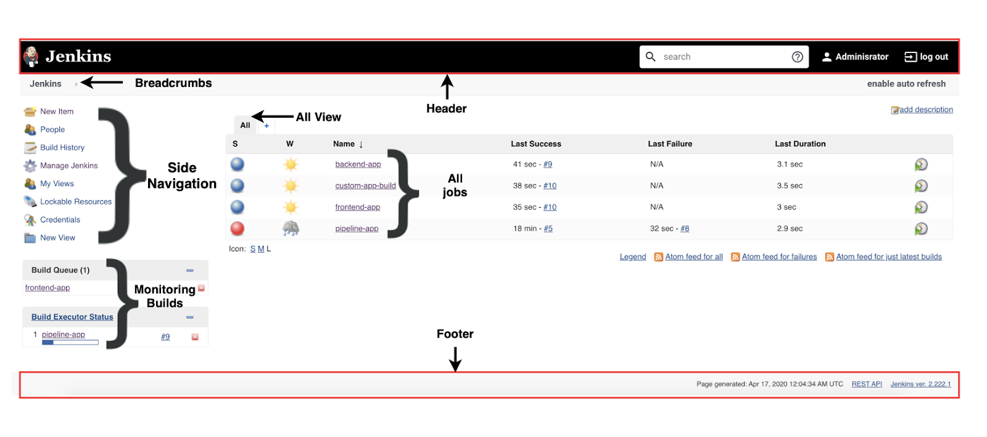
Jenkins Dashboard
The Jenkins dashboard is the main entry point for your Jenkins user interface. In this chapter, we will give an overview of the Jenkins dashboard - the information it displays to the end users and its core capabilities.
The dashboard primarily consists of the following sections:
Header
Side Navigation
All View for Jobs/Projects
Monitoring Builds
Footer

Slide 17
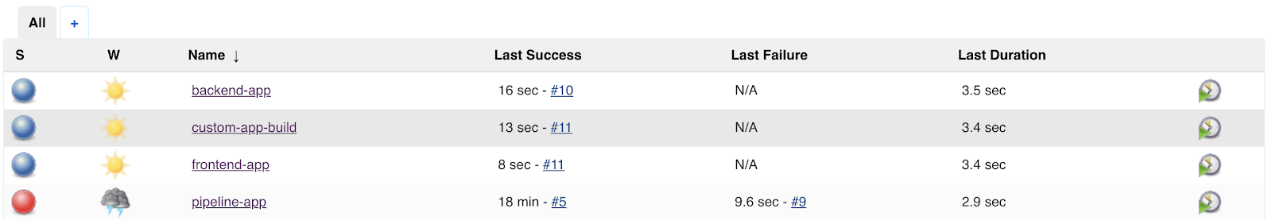
Dashboard Sections: All View for Jobs/Projects
For a given job in this list, the following information is indicated:
Build Status (S) Uses color codes (described below in more detail).
Health/Build Stability (W) Uses weather icons (described below in more detail).
Job Name
Last Success Displays when was the last time the job built successfully, and the related build number.
Last Failure Displays when was the last time the build failed, and the related build number.
Last Duration How long did the latest build take to run?
(icon) To start a build.

Slide 18
Build Status
Build Status | Color Code
Build is currently in progress | Flashing Blue/Grey
Build is successful | Blue
Aborted build | Grey
Failed build | Red

Slide 19





Health/Build Stability
Health/Build Stability | Weather Icon
If > 80% of the build runs are successful
If 61% - 80% of the build runs are successful
If 41% - 60% of the build runs are successful
If 21% to 40% of the build runs are successful
If < 21% of the build runs are successfully

Slide 20
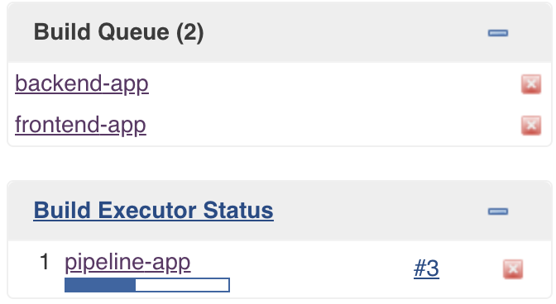
Dashboard Sections: Monitoring Builds
Monitoring builds has two subsections
Build Queue
The Build Queue section displays all the jobs that are currently queued and waiting for an executor to free up. You can click on the queued job to retrieve more information on the job. Alternatively, you can cancel the job by clicking on the red colored X icon, which is displayed next to the job.
Build Executor Status
The Build Executor Status lists all the builds that are currently in progress by each configured agent. You can click on the progress bar to view the build console output. You can also view the Jenkins Node dashboard which lists all the nodes (master, agents) by clicking on the Build Executor link.

